Slide 1
Heart Failure Hospitalization Incidence Data Set Derivation for Jackson Heart Study
JHS CCDC
Sep. 01, 2015

Slide 2
Question:
Heart Failure Hospitalization event is only adjudicated after 01/01/2005 in Jackson Heart Study, and the purpose of this presentation is to describe the strategy and justification to derive incidence data set for Heart Failure Hospitalization.

Slide 3
Facts and Strategies (I)
Heart Failure Hospitalization event is adjudicated after 01/01/2005, and our goal is to assess the Heart Failure Hospitalization status on 01/01/2005 to derive the Heart Failure Hospitalization Incidence data set.
We do not have direct question and assessment for Heart Failure Hospitalization status on 01/01/2005 or at Visit 1 or Visit 2 Exam for JHS---Gothenburg Algorithm may be an alternative solution.
To assess Heart Failure Hospitalization status on 01/01/2005, we should depend on self-reported annual follow up questionnaire data (lack of quality control).

Slide 4
Facts and Strategies (II)
In addition, we also combined AFU reported Heart Failure Hospitalization events from V1 to 01/01/2005 with adjudicated Heart Failure Hospitalization events from 01/01/2005 to 12/31/2012 to generate second set of incident Heart Failure Hospitalization variables used for sensitivity analysis.

Slide 5
Facts and Strategies (III)
The incident HF hospitalization variables used for main analysis:
Assess Start Point: 01/01/2005 or time point when the fact of negative HF status is confirmed
HF hospitalization: all adjudicated
The incident HF hospitalization variables used for sensitivity analysis:
Assess Start Point: V1
HF hospitalization: AFU reported Heart Failure Hospitalization events from V1 to 01/01/2005 and adjudicated Heart Failure Hospitalization events from 01/01/2005 to 12/31/2012

Slide 6
AFU Questions for Heart Failure Hospitalization
Majority of information came from AFU data using AFU form version A/B (form effective date 8/23/2001), and we may also depend on some AFU data using AFU form version C (form effective date 10/14/2008).

Slide 7
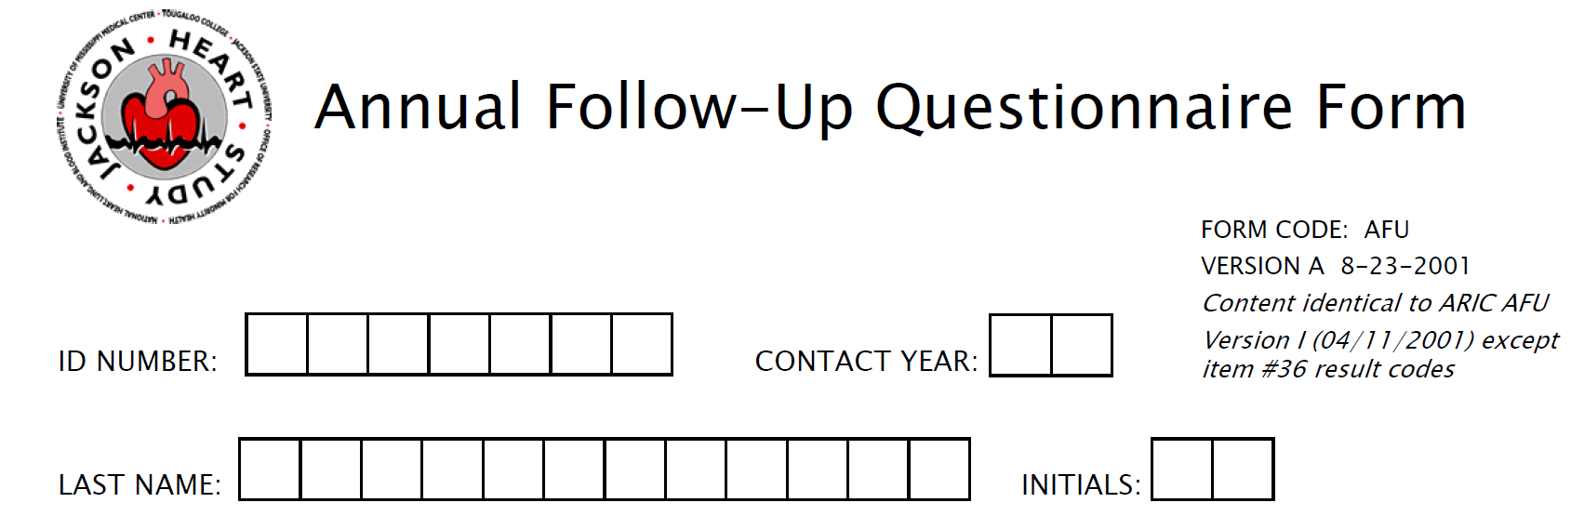
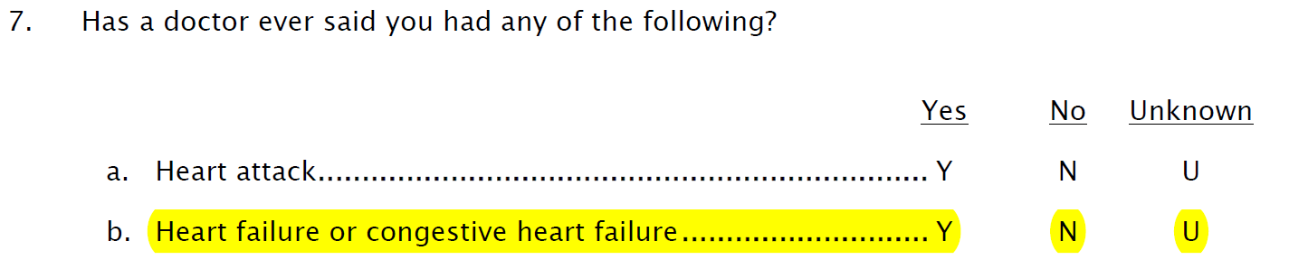
AFU Form Version A

Slide 8

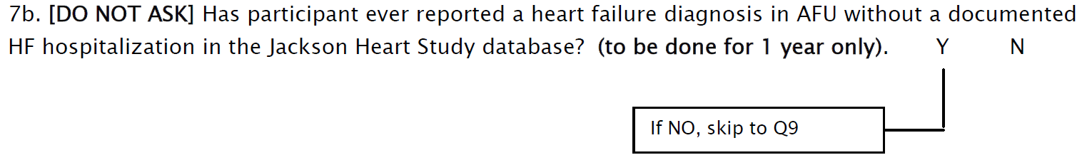
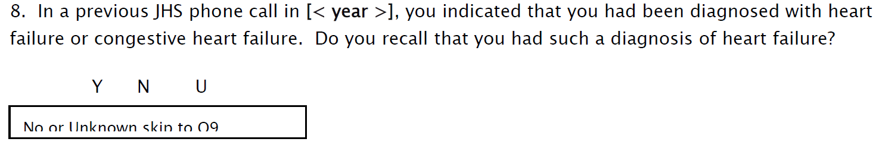
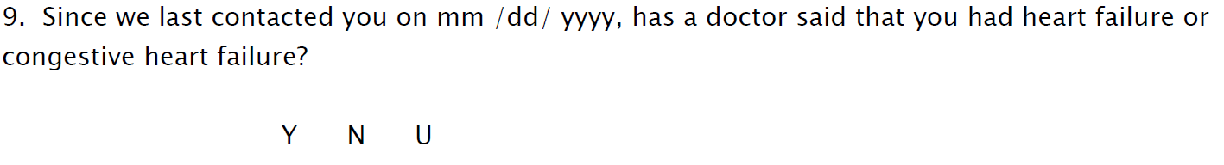
AFU Form Version C

Slide 9
Several Notes
Question 7b from Form A (“ever”) and Question 9 from Form C (“since your last exam on mm/dd/year”) are different.
Question 7b from Form A and Question 9 from Form C mapped two variables HFEVER and HFLASTCNTCT in organized AFUlong data set generated by JHS Data Coordinating Center
HFEVER and HFLASTCNTCT only exist in main AFU forms (A, B, C, D and E) but not other forms (OA, OB, OC and OD) in AFUlong data set
All AFU before 01/01/2005 used Form A (“ever” question) and generated HFEVER variable in AFUlong).

Slide 10
Objective
Derive two sets of HF Hospitalization incident variables;
The first set variable, incident HF Hospitalization assessed from around 01/01/2005 to 12/31/2012, with AFU data to determine HF Hospitalization status on 01/01/2005 --- suggested for main analysis
The second set variable, incident HF Hospitalization assessed from V1 to 12/31/2012, HF Hospitalization events between V1 to 01/01/2005 used AFU data, HF Hospitalization events between 01/01/2005 to 12/31/2012 used adjudicated HF Hospitalization data ---- suggested for sensitivity analysis

Slide 11
Part I: Derivation of Incident HF Hospitalization from 01/01/2005 using AFU data to determine HF Hospitalization status on 01/01/2005 – Main Analysis Variable Derivation

Slide 12
Start Population
Start Population with consent “yes” for medical review question after 01/01/2005 and also alive on 01/01/2005 for HF adjudication: N = 5042
The remaining 264 subjects (84 confirmed deceased and 180 gave negative consent before 01/01/2005) were classified as additional category.

Slide 13
Individuals that reported HF Hospitalization before 01/01/2005 (N = 181)
1.1 N = 134 (Cat = 1)
01/01/2005
N Y Y Y
1 N = 181
01/01/2005
At least one Y
1.2 N = 47 (Cat = 2)
01/01/2005
N Y N Y

Slide 14
Final Study Population at risk for incident Heart Failure Hospitalization: 3530 + 932 = 4462

Slide 15
Individuals that did not report HF Hospitalization at any AFU before 01/01/2005 (N = 3713)
2.1.1 N = 13 (Cat = 3)
01/01/2005
2.1 N = 3543
01/01/2005
N N N N
N …
Adjudicated HF Hospitalization Event
2.1.2 N = 3530 (Cat = 4)
01/01/2005
N N N N
N …
2 N = 3713
01/01/2005
N N N N
N …
2.2 N = 66 (Cat = 5)
01/01/2005
Assess Start Point
N N N N
N N N N
Y …
467 answers ‘N’ from Form C Question 9
3063 answers ‘N’ from Form A Question 7b
Both answers can be used
2.3 N = 104 (Cat = 6)
01/01/2005
N N N N
Missing Missing

Slide 16
Individuals missing HF question answer for all AFUs before 01/01/2005 (N = 1148)
3.1.1 N = 1 (Cat = 7)
01/01/2005
Missing Missing …
N …
3.1 N = 1051
01/01/2005
3.1.2 N = 932 (Cat = 8)
01/01/2005
N …
Missing Missing …
N …
Missing Missing …
Assess Start Point
3 N = 1148
01/01/2005
3.1.3 N = 118 (Cat = 9)
01/01/2005
3.2 N = 25 (Cat = 10)
01/01/2005
Missing Missing …
N …
Missing Missing …
Missing Missing …
Y …
3.3 N = 72 (Cat = 11)
01/01/2005
116 answers ‘N’ from Form C Question 9 (can not be used)
933 answers ‘N’ from Form A Question 7b (can be used)
Missing Missing …
Missing Missing …

Slide 17
Individuals that deceased or gave negative consent before 01/01/2005 (N = 264)
4 N = 264 (Cat = 12)
01/01/2005
Deceased or gave negative consent

Slide 18
Heart Failure Hospitalization Incidence Data Set
cat | Frequency | Percent | Cumulative Frequency | Cumulative Percent
1 | 134 | 2.53 | 134 | 2.53
2 | 47 | 0.89 | 181 | 3.41
3 | 13 | 0.25 | 194 | 3.66
4 | 3530 | 66.53 | 3724 | 70.18
5 | 66 | 1.24 | 3790 | 71.43
6 | 104 | 1.96 | 3894 | 73.39
7 | 1 | 0.02 | 3895 | 73.41
8 | 932 | 17.57 | 4827 | 90.97
9 | 118 | 2.22 | 4945 | 93.20
10 | 25 | 0.47 | 4970 | 93.67
11 | 72 | 1.36 | 5042 | 95.02
12 | 264 | 4.98 | 5306 | 100.00

Slide 19
Heart Failure Hospitalization Incidence Data Set
hf | Frequency | Percent | Cumulative Frequency | Cumulative Percent
. | 844 | 15.91 | 844 | 15.91
0 | 4225 | 79.63 | 5069 | 95.53
1 | 237 | 4.47 | 5306 | 100.00

Slide 20
Heart Failure Hospitalization Incidence Data Set (Assessed from 01/01/2005, suggested for Main Analysis)
SubjID
HF: Heart Failure Hospitalization status, HF = 1, N = 237; HF = 0, N = 4225; HF = . N = 844;
Examdate: HF Hospitalization incidence assessment start point, 01/01/2005 for cat = 4 and first AFU after 01/01/2005 for Cat = 8;
Date: Censoring time or event time;
Year: Censoring year or event year;
Years: total HF Hospitalization assessed years;
Days: total HF Hospitalization assessed days;
Contacttype
Cat: Categories specified representing different HF Hospitalization status at incidence assessment start point by AFU

Slide 21
Part II: Derivation of Incident HF Hospitalization from V1 by combining AFU HF Identification Information Start Population: N = 5306

Slide 22
Individuals that reported HF positive at first AFU after V1 (N = 126)
01/01/2005
1 N = 126 (Cat = 1)
Y Any answer
First AFU Y

Slide 23
Individuals that reported HF negative at first AFU after V1 but at least one HF positive before 01/01/2005 (N = 68)
2.1 N = 52 (Cat = 2) with AFU identified HF event
N Y Y Y
01/01/2005
01/01/2005
2 N = 68
N At least one Y
2.2 N = 16 (Cat = 3) with AFU identified HF event
N Y N Y
01/01/2005
middle point of first HF positive and previous HF negative AFU date

Slide 24
Individuals that did not report HF at any AFU before 01/01/2005 (N = 3872)
Adjudicated Events identified: event time specified as first adjudicated event time after 01/01/2005
3.1 N = 3650 (Cat = 4)
N N N N
N …
Adjudicated HF Event
01/01/2005
3.2.1 N = 8 (Cat = 5)
01/01/2005
3.2 N = 68
N N N N
Y …
3 N = 3872
01/01/2005
N N N N
N N N N
Y …
3.2.2 N = 60 (Cat = 6) with AFU identified HF event
01/01/2005
3.3 N = 154 (Cat = 7)
N N N N
Y …
01/01/2005
N N N N
Missing Missing
01/01/2005
Adjudicated Events not identified: event time specified as middle point of last AFU before 01/01/2005 and 01/01/2005

Slide 25
Individuals missing HF question answer for all AFUs before 01/01/2005 (N = 1240)
4.1.2 N = 984 (Cat = 8)
4.1 N = 1109
Missing Missing …
N …
01/01/2005
Missing Missing …
N …
01/01/2005
4.1.3 N = 125 (Cat = 9)
01/01/2005
4 N = 1240
01/01/2005
4.2 N = 25 (Cat = 10)
Missing Missing …
N …
Missing Missing …
Missing Missing …
Y …
01/01/2005
123 answers ‘N’ from Form C Question 9 (can not be used)
985 answers ‘N’ from Form A Question 7b (can be used)
3.3 N = 106 (Cat = 11)
Missing Missing …
Missing Missing …
01/01/2005

Slide 26
Heart Failure Hospitalization Incidence Data Set
cat | Frequency | Percent | Cumulative Frequency | Cumulative Percent
1 | 126 | 2.37 | 126 | 2.37
2 | 52 | 0.98 | 178 | 3.35
3 | 16 | 0.30 | 194 | 3.66
4 | 3650 | 68.79 | 3844 | 72.45
5 | 8 | 0.15 | 3852 | 72.60
6 | 60 | 1.13 | 3912 | 73.73
7 | 154 | 2.90 | 4066 | 76.63
8 | 984 | 18.55 | 5050 | 95.18
9 | 125 | 2.36 | 5175 | 97.53
10 | 25 | 0.47 | 5200 | 98.00
11 | 106 | 2.00 | 5306 | 100.00

Slide 27
Heart Failure Hospitalization Incidence Data Set
hf | Frequency | Percent | Cumulative Frequency | Cumulative Percent
. | 536 | 10.10 | 536 | 10.10
0 | 4384 | 82.62 | 4920 | 92.73
1 | 386 | 7.27 | 5306 | 100.00

Slide 28
Heart Failure Hospitalization Incidence Data Set (Assessed from V1, Suggested for Sensitivity Analysis)
AFUHF: Heart Failure Hospitalization status, AFUHF = 1, N = 386; HF = 0, N = 4384; HF = . N = 536;
AFUExamdate: HF Hospitalization incidence assessment start point, all from V1;
AFUDate: Censoring time or event time;
AFUYear: Censoring year or event year;
AFUYears: total HF Hospitalization assessed years;
AFUDays: total HF Hospitalization assessed days;
AFUContacttype
AFUCat: Categories specified representing different identification sources (AFU or adjudication) of HF Hospitalization events

